Slide 1
Cell Viability of Curcumin Treated T-C1 (MTS)
Davit Sargsyan, 04/29/2016

Slide 2
Experiment Timeline
Monday 04/18/2016: 3 96-well plates were seeded with 10^3 cells per well.
Tuesday 04/19/2016: 8 doses of Curcumin were applied to the plates, highest to lowest from Column 2 to Column 9 respectively; column 10 was left as a positive control; edges were filled with medium.
Wednesday – Friday (04/20/2016 to 04/22/2016): every day, for 3 consecutive days, one plate was taken out, MTS was applied to wells, and plate readings were taken 2 hours later.

Slide 3
Design and Analysis
TRAMP-C1 cells were dosed with serially diluted (. . . /2) Curcumin. Each of the 3 96-well plate contained 6 replicas for each of the 9 doses, plus DMSO control and medium control (background). Plates were analyzed at 24, 48 and 72 hours. Each plate was red twice. The results are presented below.
Data was analyzed using R 3.2.1. The estimates and plots were obtained using my robust 4-parameter curve fitting R package ‘ricf’.

Slide 4
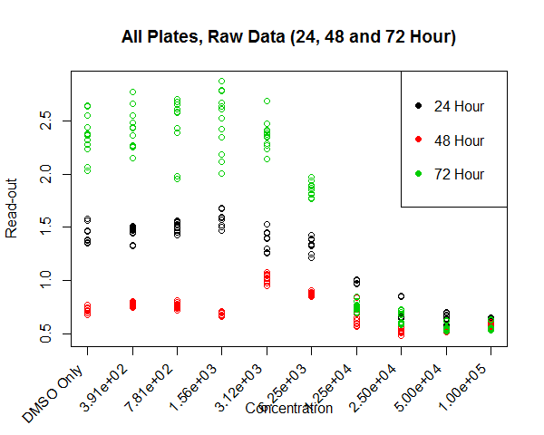
Raw Read-outs

Slide 5
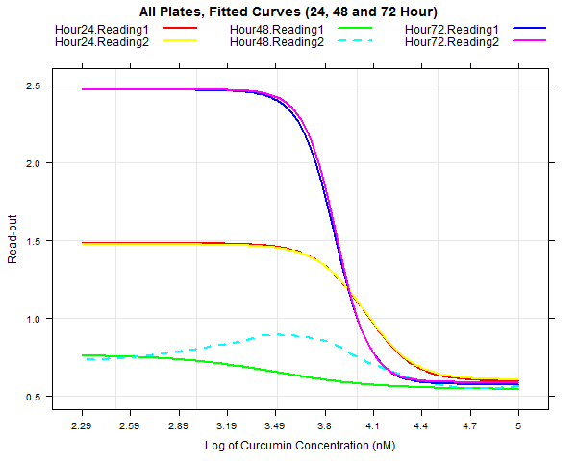
Curves Fitted to Read-outs

Slide 6
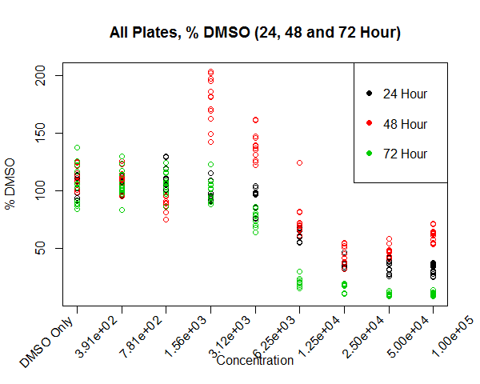

%DMSO Data
$\%DMSO= \frac{100∗(Treatment −Median(Plate Background)}{Row DMSO −Median(Plate Background)}$

Slide 7
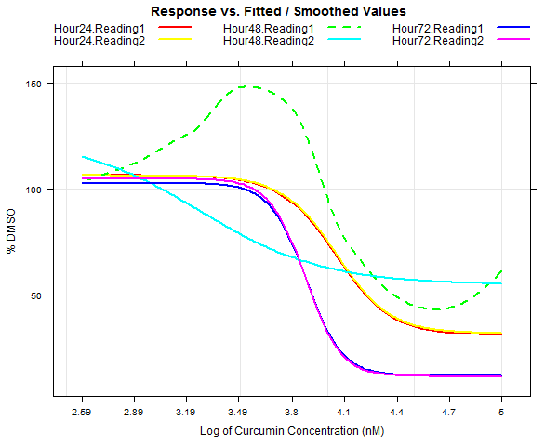
Curves Fitted to %DMSO

Slide 8
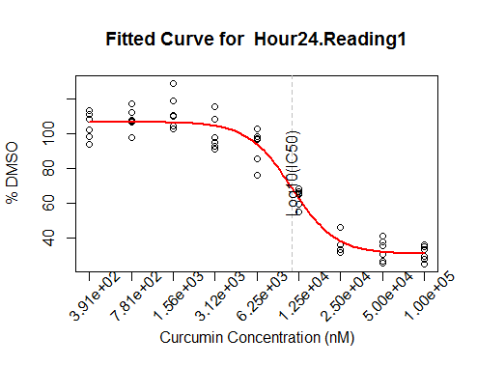
Robust IC20/50/80 Estimates 24 Hour/ Reading1

Slide 9

Robust IC20/50/80 Estimates 24 Hour/ Reading2

Slide 10
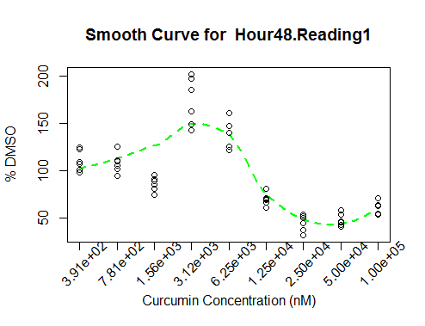
Robust IC20/50/80 Estimates 48 Hour/ Reading1
No convergence

Slide 11
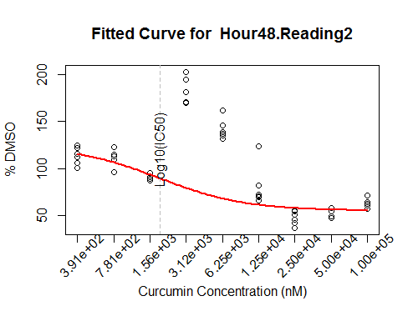
Robust IC20/50/80 Estimates 48 Hour/ Reading2

Slide 12
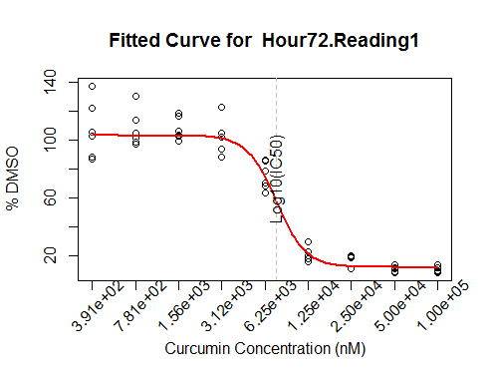
Robust IC20/50/80 Estimates 72 Hour/ Reading1

Slide 13
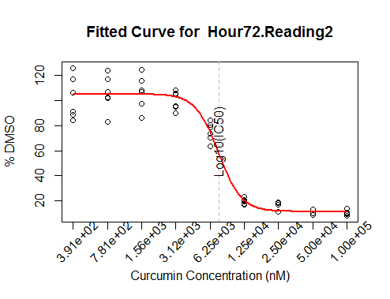
Robust IC20/50/80 Estimates 72 Hour/ Reading2

Slide 14
Discussion
Although data followed 4-parameter model well for 24 and 72 hour read-outs, 48 hour read-outs had major issues.
Variance decreased from lowest to highest doses at 72 hours but the robust model assumed homogeneity of variance across concentrations. Although this might not have influenced the estimates in this case, generally a transformation of the response might be needed to stabilize variance.
Hook effect was observed at low doses at 24 hours. A model that can describe the hook might be more appropriate, especially if the hook effect becomes more pronounced.
Smaller intervals between the doses can be beneficial as we can get smoother curves around IC50 values and decrease standard errors of the estimates.

